Slide 1
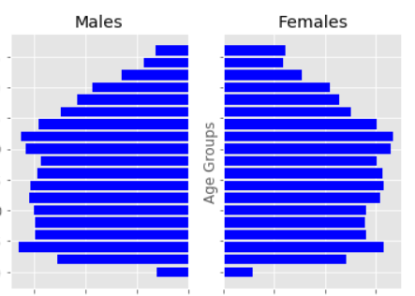
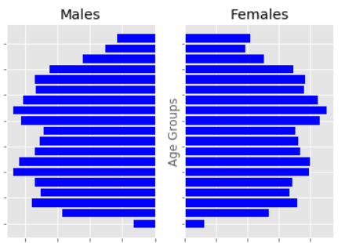
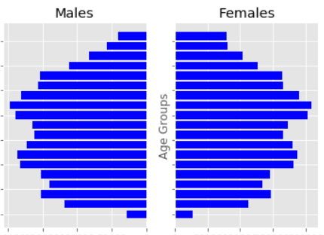
United Kingdom – Where are they today?
Demographics in 2017
Northern Ireland
Scotland
England & Wales
Northern Ireland has a younger population than some of the other regions
England, Wales and Scotland appear to have similar demographics

Slide 2
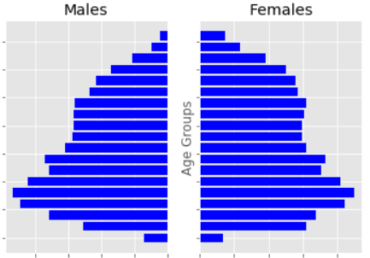
Scotland: Then and Now
An aging population
1981
2017
The most striking difference between 1981 and 2017 is the shift from a younger to an older population. In 1981 the majority of the population could be found in the 8 youngest age groups. In 2017 we see a more pronounced bump in the ages between 40 and 70
Part of the challenge for Scotland in the future will be supporting retirees on a smaller base with regards to social security

Slide 3
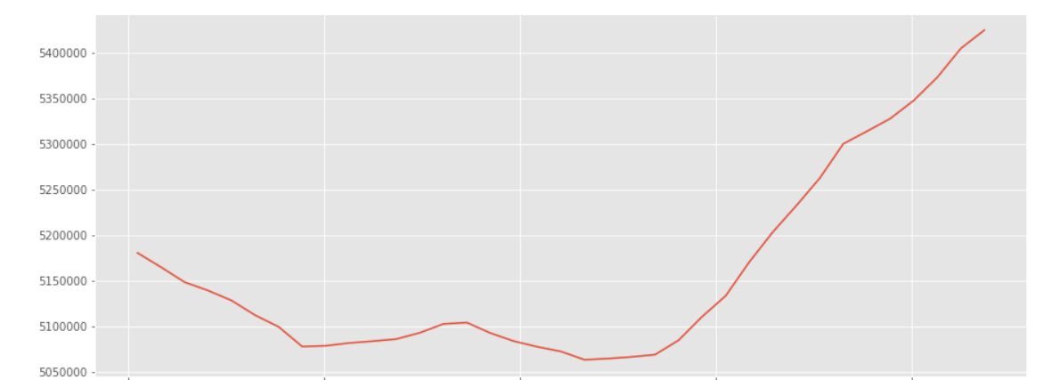
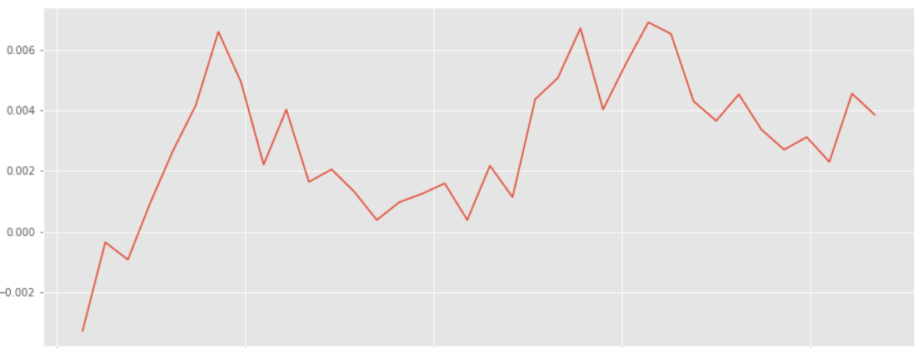
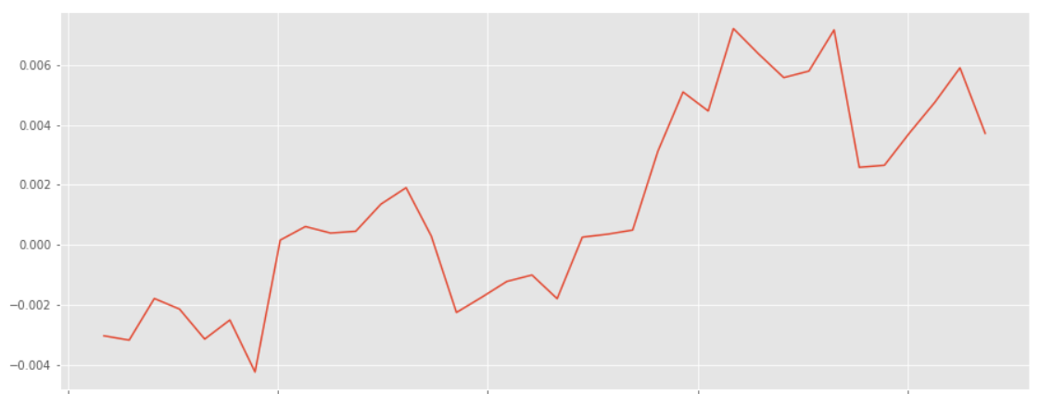
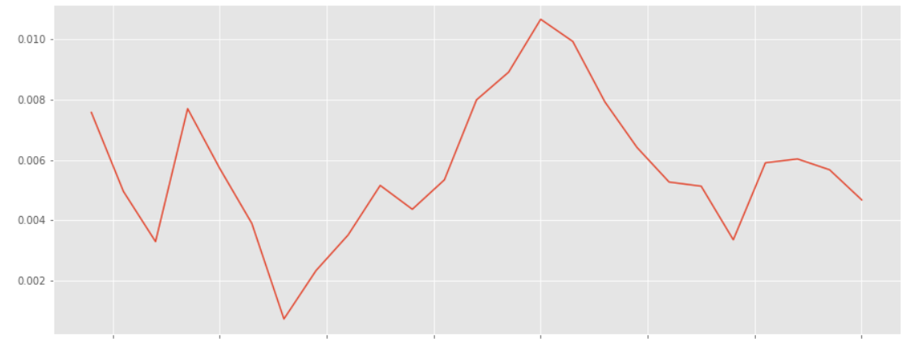
Further Insights
Scotland had a noticeable population decline and stagnation in the 80s and 90s before rebounding strongly
Over the last ten years or so, Wales, Scotland and Northern Ireland all are experiencing a trend of declining, albeit positive, growth rates for their populations.
1981-2017: Population Growth (YoY% Change)
Scotland
Northern Ireland
Wales

